Slide 1
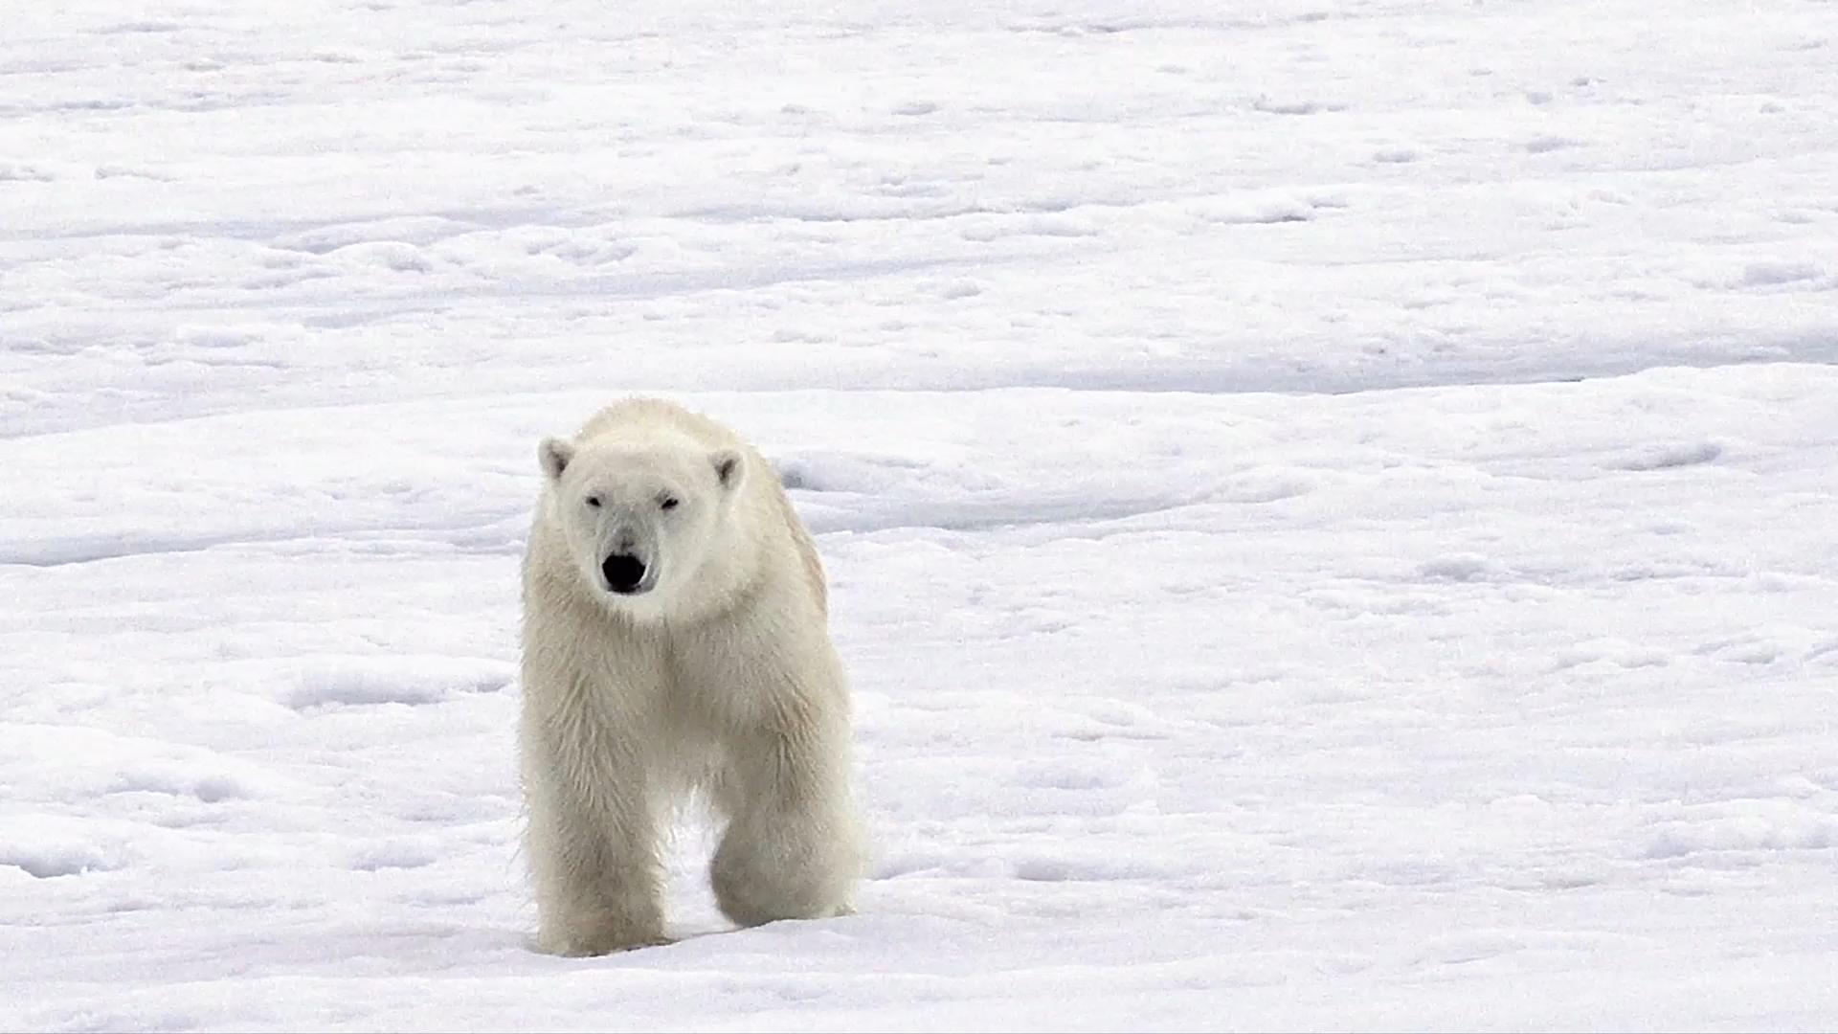
Intro to Polars
Center for Data and Visualization Sciences
Joel Herndon joel.herndon@duke.edu
September 9, 2025

Slide 2
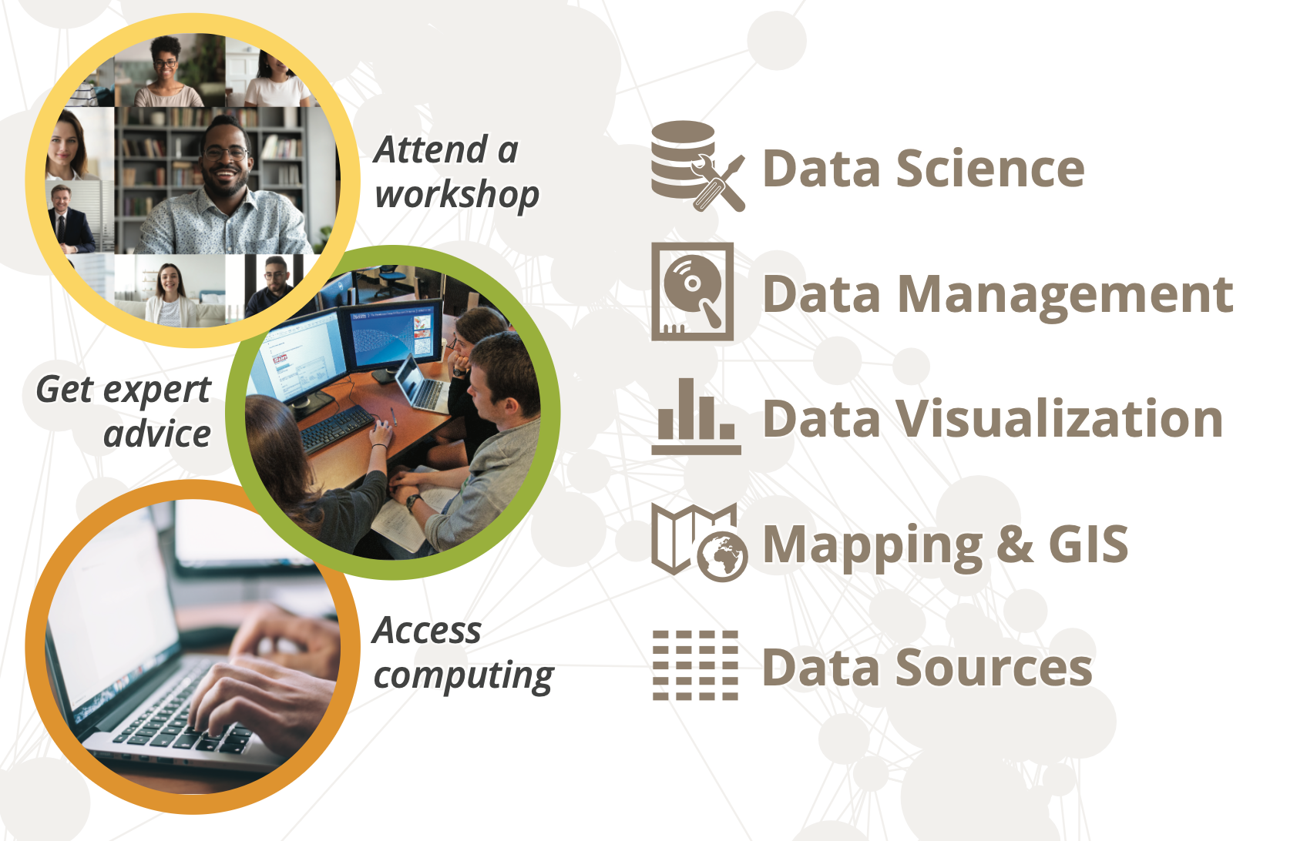
askdata@duke.edu

Slide 3
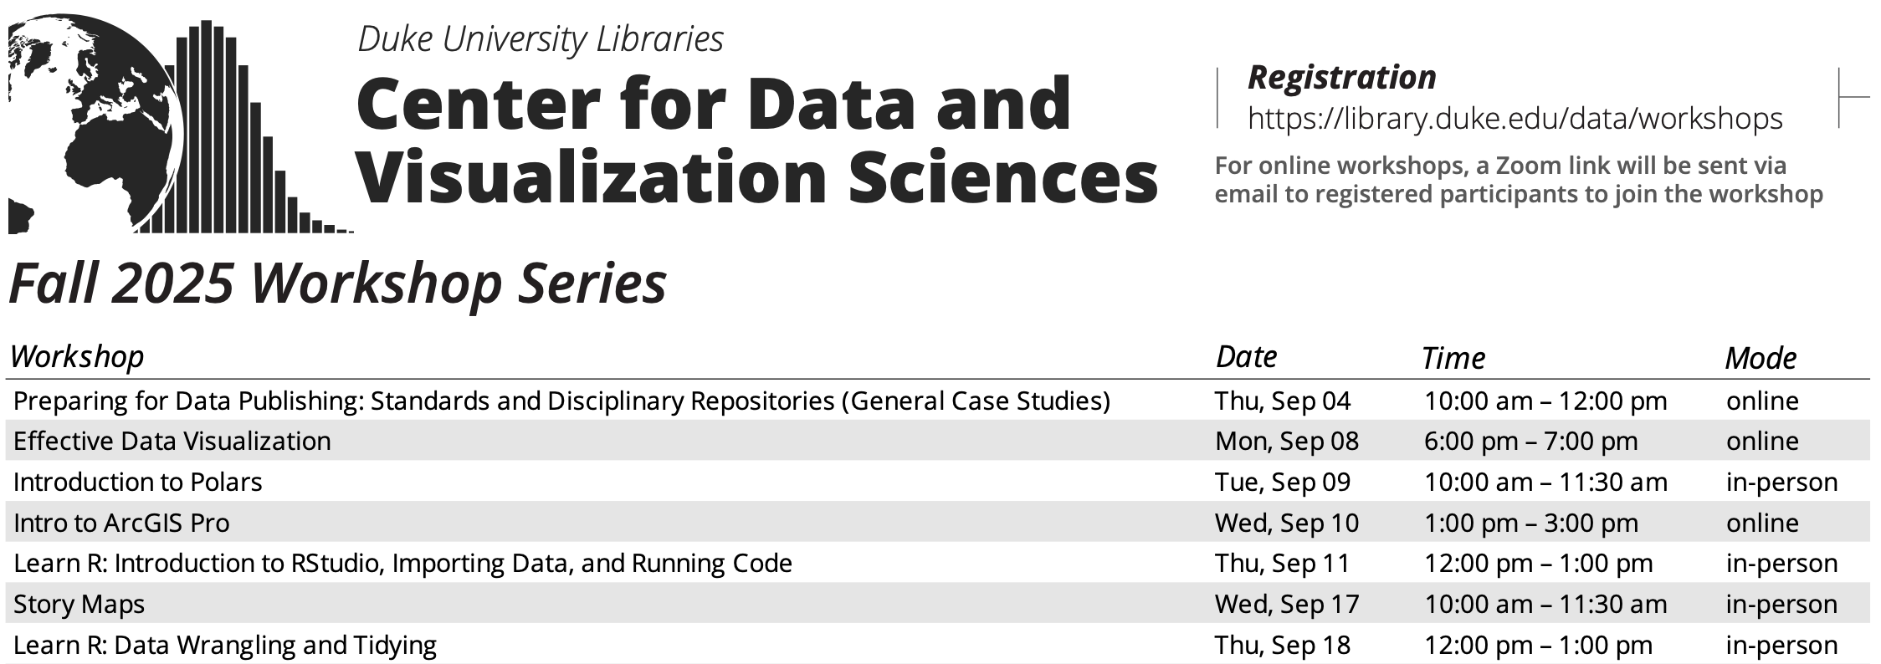
library.duke.edu/data/workshops

Slide 4
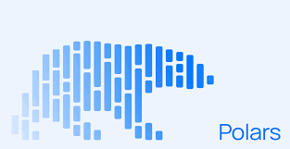
Intro to Polars: Workshop Materials
Workshop materials: https://duke.is/polars-fall-25
Google Colab: colab.research.google.com
Get help: askdata@duke.edu

Slide 5
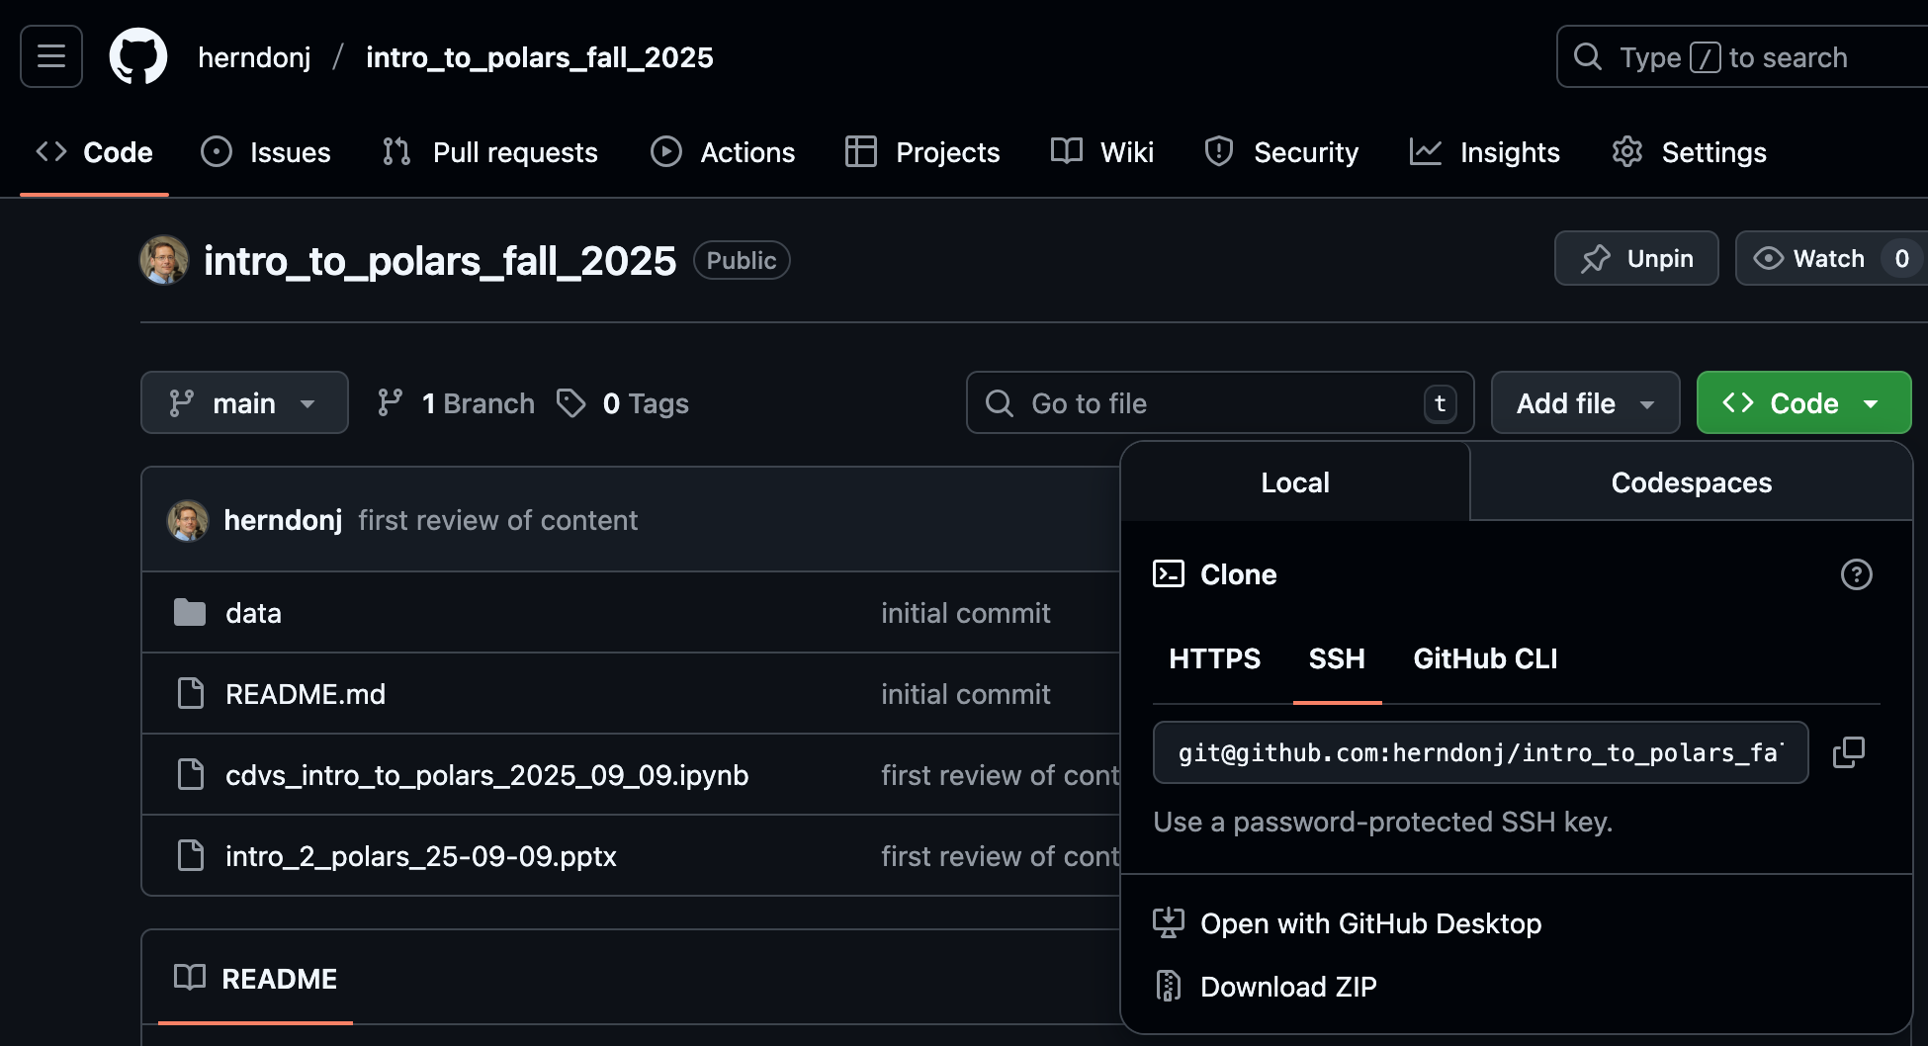
1. Click here
2. Then, click here…

Slide 6
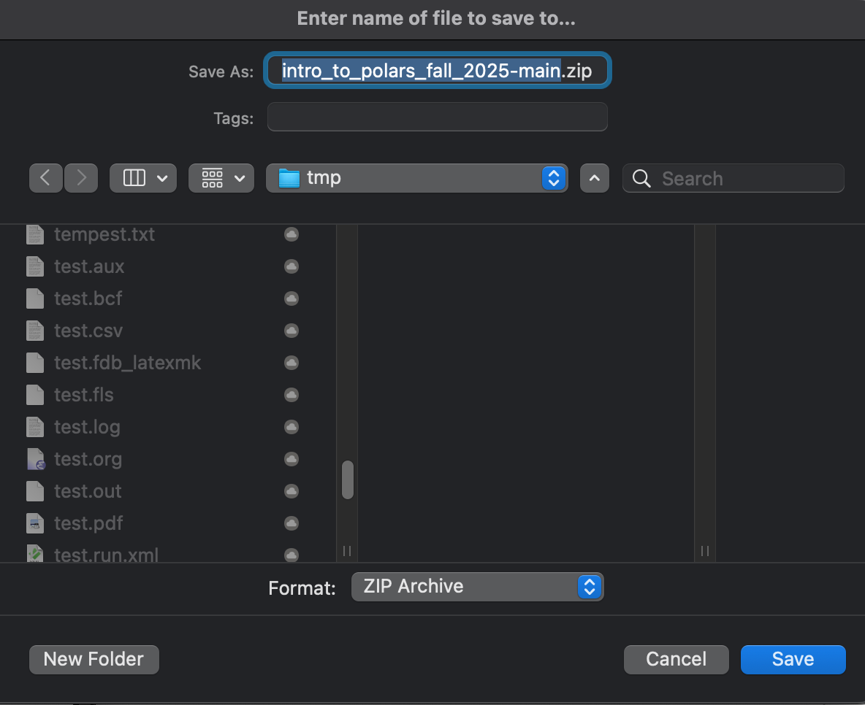
3. Keep track of the where you save and uncompress the file!

Slide 7
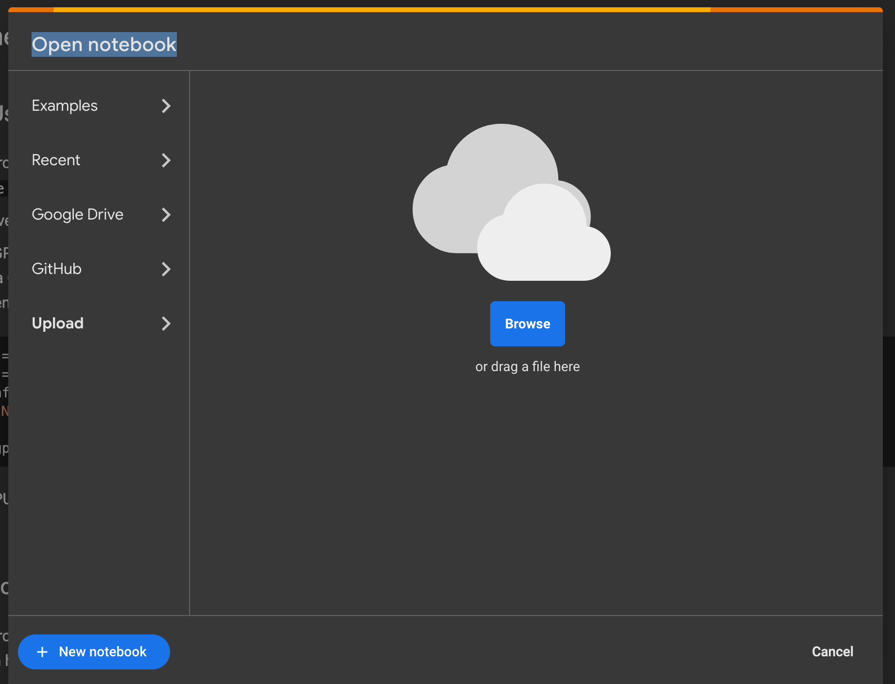
colab.research.google.com
2. Then, click here…
1. Click here

Slide 8
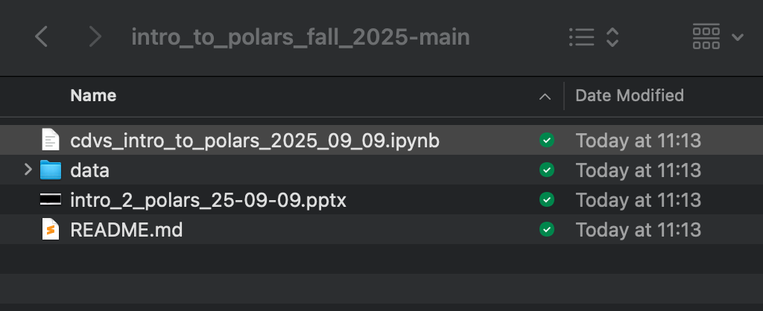
3. Select “cdvs_intro… .ipynb” (see below)

Slide 9
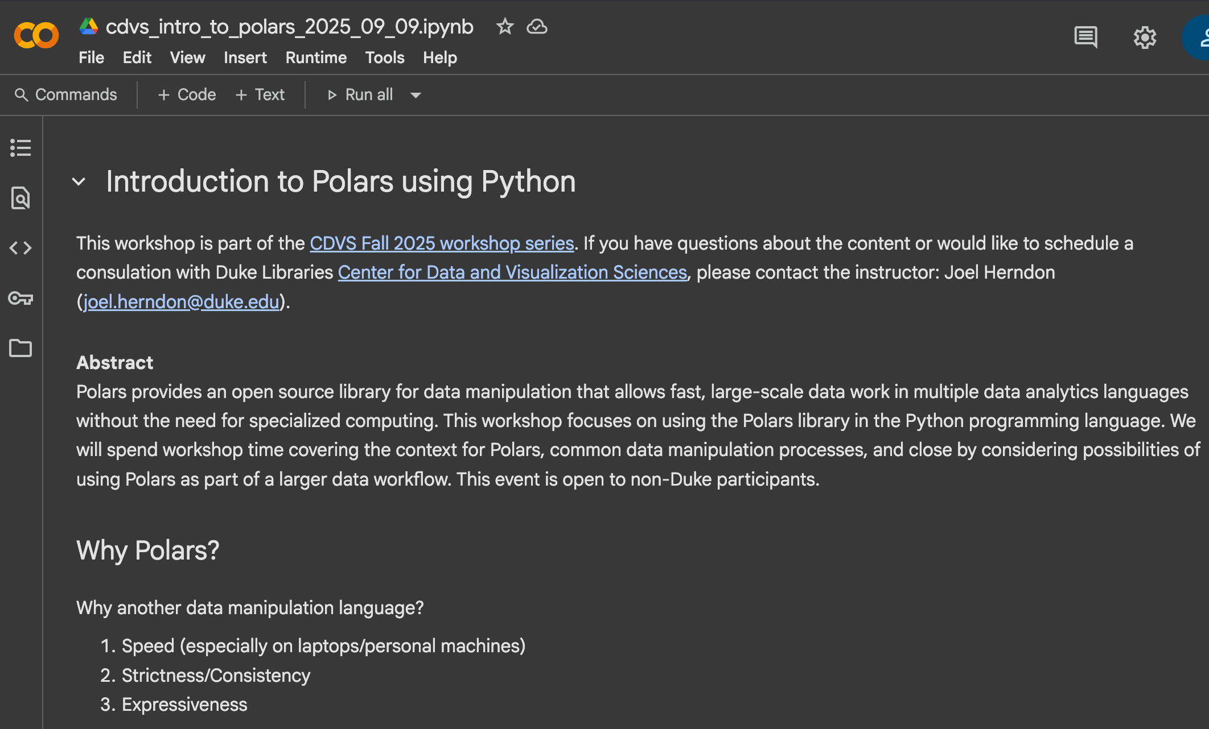
Success!

Slide 10
Workshop Rules and goals
Accept questions throughout presentation
Demonstrate “enough Polars” to assess its usefulness
Provide clear examples that suggest Polars capabilities.
Reduce friction by using a cloud environment (but allow other IDEs)
Accept constructive feedback

Slide 11
Why Polars?
Expressiveness
Speed
Strictness (or consistency)
“Come for the speed, stay for the API”
– Janssens and Nieuwdorp, 2025

Slide 12
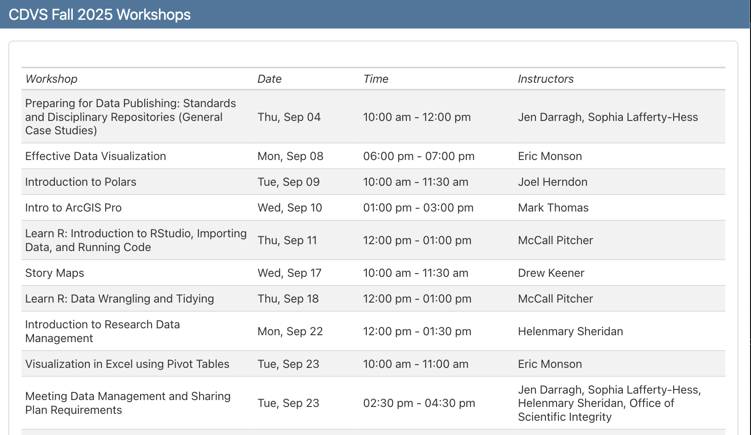
Polars in use: Dashboards

Slide 13
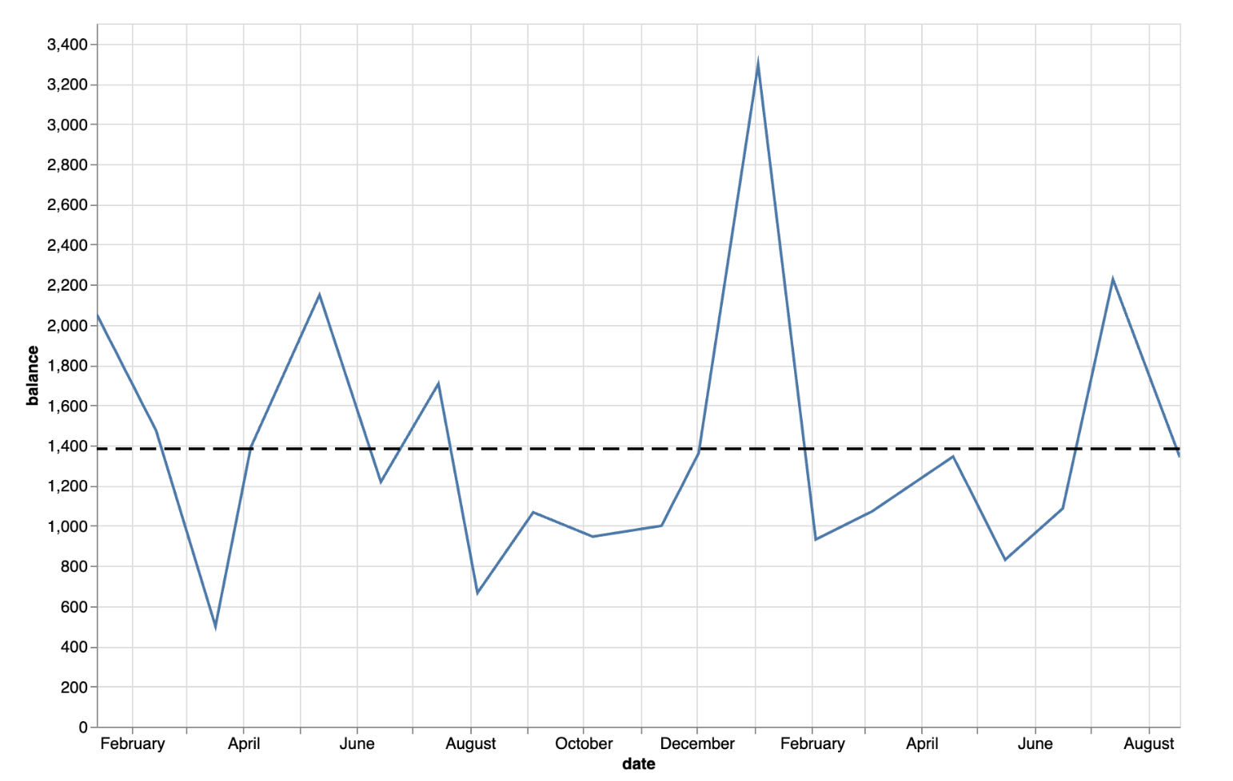
Polars in use: Charts

Slide 14
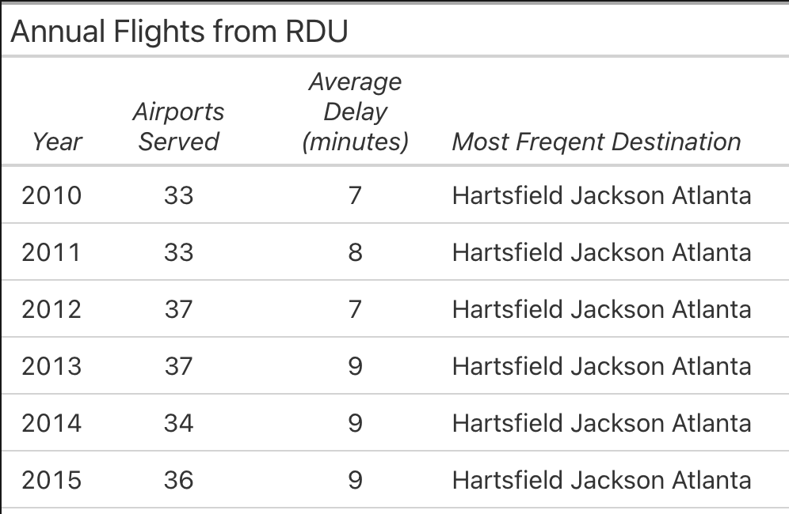
Polars in use: Summary Tables

